Slide 1

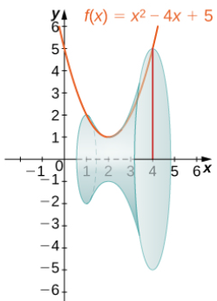
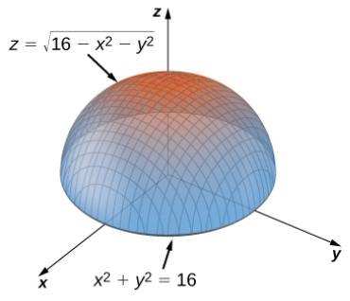
CALCULUS
Notes:
General introduction to calculus, tools and applications.
Calculus: Phép tính vi – tích phân

Slide 2
Chapter 1: Function and limit
Contents
1.1. Functions and their representations
1.2. Mathematical models.
1.3. The limit of a function.
1.4. Calculating limits using the limit laws.
1.5.Continuity.
1.6. Limits involving infinity
Notes:
the importance of basic elementary functions, limits and continuity
Function and limit: Hàm số và giới hạn

Slide 3
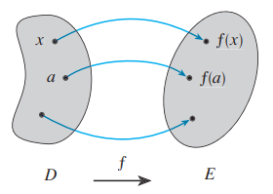

1.1 Functions and their representations
Function
A function f is a rule that assigns to each element x in a set D exactly one element, called f (x), in a set E.
Notes:
exactly one ; D, E in R; domain and range;

Slide 4
1.1 Functions and their representations
Example:
Input (x) | Out put y=f(x)
Side length x | area of a square x²
the weight of the package | cost of mailing a package
amount of time the ball is in the air | velocity of a ball thrown in the air
Time of Day | Temperature

Slide 5
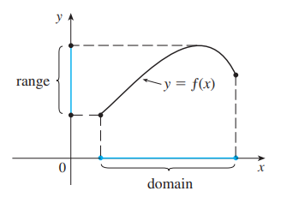
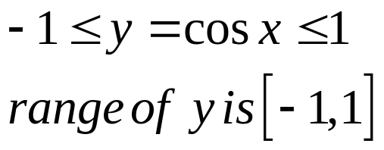
1.1 Functions and their representations
Domain and range
- The set D is called the domain of the function f.
- The range of f is the set of all possible values of f (x) as x varies throughout the domain.
Notes:
exactly one ; D, E in R; domain and range;

Slide 6
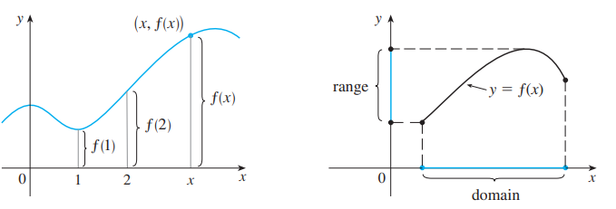
1.1 Functions and their representations
Graph
The graph of f is the set of all points (x, y) in the coordinate plane such that y = f(x) and x is in the domain of f.
The graph of f also allows us to picture:
  - The domain of f on the x-axis
  - Its range on the y-axis
Notes:
Perpendicular projection of the graph to the Ox is domain
Perpendicular projection of the graph to the Oy is range

Slide 7
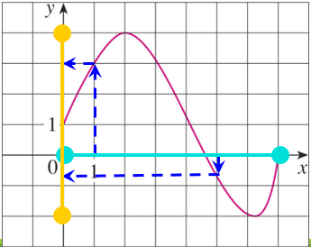
1.1 Functions and their representations
Graph
Example 1:The graph of a function f is shown.
a/ Find the values of f(1) and f(5).
b/What is the domain and range of f ?

Slide 8
1.1 Functions and their representations
Graph
Solution:
a/ f(1) = 3; f(5) ≈ - 0.7
b/ D = [0, 7]
Range(f) = [-2, 4]

Slide 9
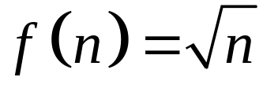

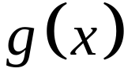

1.1 Functions and their representations
Representations
DISCUSSION
Find the domain and region of the
functions ( if it is a function).
a/ for all natural numbers
b/ is any real number such that larger than
Notes:
Any real number

Slide 10
1.1 Functions and their representations
Representations of funtions
There are four possible ways to represent a function:
  - Algebraically (by an explicit formula)
  - Visually (by a graph)
  - Numerically (by a table of values)
  - Verbally (by a description in words)
Notes:
depending on situations where there is a suitable description

Slide 11

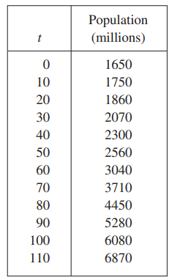
1.1 Functions and their representations
Example:
The human population of the world P depends on the time t.
  - The table gives estimates of the
  world population P(t) at time t,
  for certain years.
  - However, for each value of the
  time t, there is a corresponding
  value of P, and we say that
  P is a function of t.

Slide 12
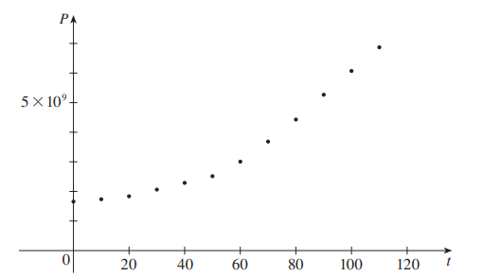
1.1 Functions and their representations
Example:
The human population of the world P depends on the time t.
  If we plot these values, we get the
  graph (called a scatter plot).

Slide 13
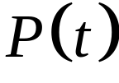

1.1 Functions and their representations
Example:
What about a formula ?
Of course, it’s impossible to devise an explicit formula that gives the exact human population at any time .
But it is possible to find an expression for a function that approximates .
In fact, we could use a graphing calculator with exponential
regression capabilities to obtain the approximation

Slide 14
1.1 Functions and their representations
Example:
"When you turn on a hot-water faucet, the temperature T of the water depends on how long the water has been running".
Draw a rough graph of T as a function of the time t that has elapsed since the faucet was turned on.

Slide 15

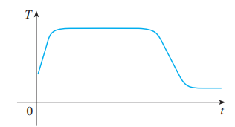
1.1 Functions and their representations
Solution:
The initial temperature of the running
water is close to room temperature
because the water has been sitting in
the pipes. When the water from the
hotwater tank starts flowing from the faucet, increases quickly. In the next phase, is constant at the tempera ture of the heated water in the tank. When the tank is drained, decreases to the temperature of the water supply. This enables us to make the rough sketch of as a function of in Figure.

Slide 16


1.1 Functions and their representations
The graph of a function is a curve in the -plane.
But the question arises:
Which curves in the -plane are graphs of functions ?
This is answered by the following test.

Slide 17
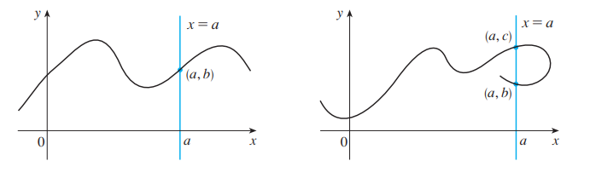
1.1 Functions and their representations
THE VERTICAL LINE TEST
A curve in the -plane is the graph of a function of if and only if no vertical line intersects the curve more than once.
It is a function Not a function

Slide 18
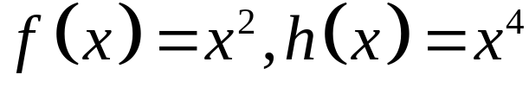
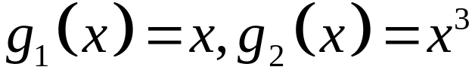
1.1 Functions and their representations
Symmetry: even function and odd function.
- If a function f satisfies: f (-x) = f (x), ∀ x ∈ D then f is called an even function.
If a function f satisfies: f (-x) = - f (x), ∀ x ∈ D then f is called an odd function.
Example:
a/ are even functions.
b/ are odd functions.
Notes:
-x also in D

Slide 19
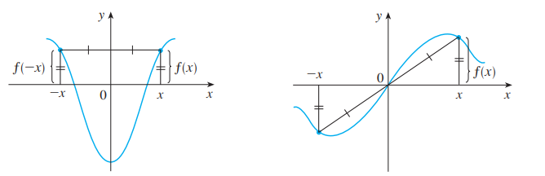
1.1 Functions and their representations
Symmetry: even function and odd function.
  Properties:
  - The geometric significance of an even function is that its graph is symmetric with respect to the y-axis.
  The graph of an odd function is symmetric about the origin.
  An even funtions An odd function
Notes:
-x also in D

Slide 20
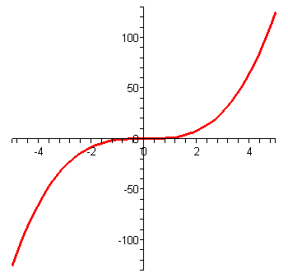
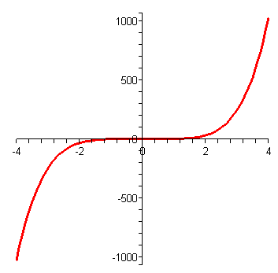
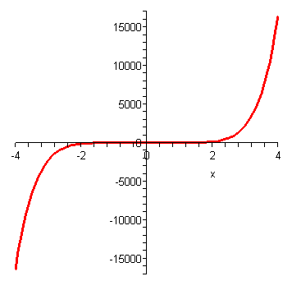
1.1 Functions and their representations
Symmetry: even function and odd function.
Example:
The graph of odd functions
y = x³
y = x⁵
y = x⁷
Notes:
-x also in D

Slide 21

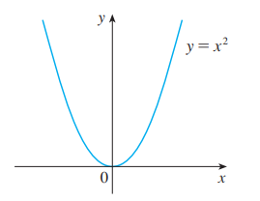
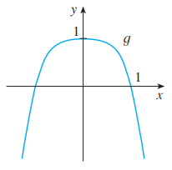
1.1 Functions and their representations
Symmetry: even function and odd function.
Example:
The graph of even functions
Notes:
-x also in D

Slide 22
1.1 Functions and their representations
Symmetry: even function and odd function.
Example:
Let f is an odd function. If (-3,5) is in the graph of f then
which point is also in the graph of f ?
a. (3,5) b. (-3,-5) c. (3,-5) d. All of the others
Notes:
Answer: C

Slide 23
1.1 Functions and their representations
Symmetry: even function and odd function.
Solution:
Let f is an odd function. If (-3,5) is in the graph of f then
which point is also in the graph of f ?
a. (3,5) b. (-3,-5) c. (3,-5) d. All of the others
Notes:
Answer: C

Slide 24
1.1 Functions and their representations
Symmetry: even function and odd function.
Example:
Suppose f is an odd function and g is an even function.
What can we say about the function f.g defined by (f.g)(x)=f(x)g(x) ?
Prove your result.
Notes:
Answer: C

Slide 25
1.1 Functions and their representations
Increasing and decreasing functions
Definition
A function f is called increasing on an interval I if:
f(x₁) < f(x₂) whenever x₁ < x₂ in I
It is called decreasing on I if:
f(x₁) > f(x₂) whenever x₁ < x₂ in I
Notes:
Monotonic

Slide 26
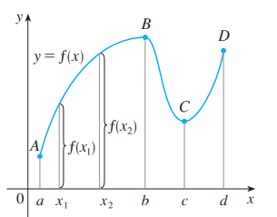
1.1 Functions and their representations
Increasing and decreasing functions
The function f is said to be increasing on the interval [a, b], decreasing on [b, c], and increasing again on [c, d].

Slide 27

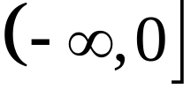
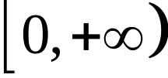
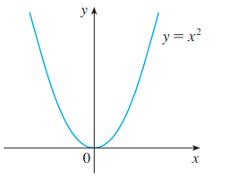
1.1 Functions and their representations
Increasing and decreasing functions
Example:
The function is
Decreasing on the interval
Increasing on the interval

Slide 28
1.1 Functions and their representations
Quiz questions
1/ If f is a function then f(x+2)=f(x)+f(2)
True b. False
2/ If f(s)=f(t) then s= t
True b . False
3/ Let f be a function. We can find s and t such that s=t and f(s) is not equal to f(t)
a. True b. False

Slide 29
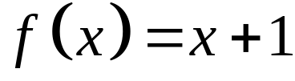
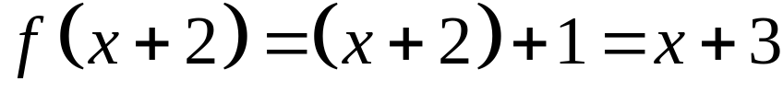
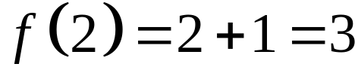
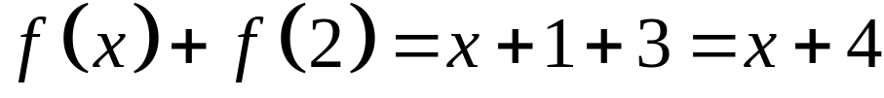
1.1 Functions and their representations
.

Slide 30
1.1 Functions and their representations
Answer:
1/ If f is a function then f(x+2)=f(x)+f(2)
True b. False
2/ If f(s)=f(t) then s= t
True b . False
3/ Let f be a function. We can find s and t such that s=t and f(s) is not equal to f(t)
a. True b. False

Slide 31

1.2. Functions and models
A mathematical model is a mathematical description—often by means of a
function or an equation of a real-world phenomenon such as:
  - Size of a population
  - Demand for a product
  - Speed of a falling object
  - Life expectancy of a person at birth
  - Cost of emission reductions
Notes:
The modeling process: developing, analyzing and interpreting a mathematical model.
Classes of functions: linear, power, rational, algebraic, trigonometric, exponential and transcendental functions.

Slide 32
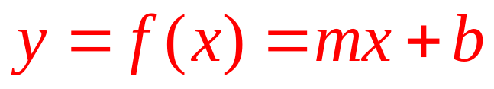
1.2. Functions and models
Linear models
When we say that y is a linear function of x, we mean that the graph of the function is a line.
So, we can use the slope-intercept form of the equation of a line to write a formula for the function as
  where m is the slope of the line and b is the y-intercept.
Notes:
the graph of the function is a line; meaning of slope and y - intercept

Slide 33



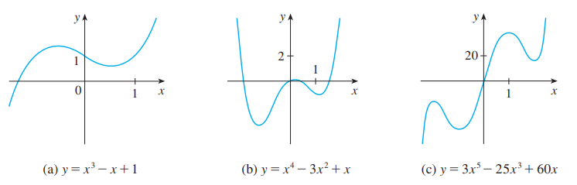
1.2. Functions and models
Polynomials
A function P is called a polynomial if
Where is a nonnegative integer and the numbers
are constants called the coefficients of the polynomial.
Notes:
a_{n} ≠0

Slide 34

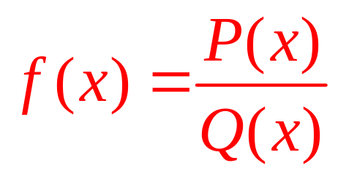
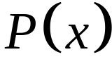
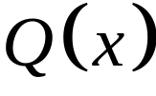
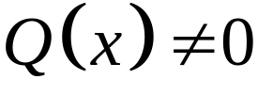
1.2. Functions and models
Rational functions
A rational function is a ratio of two polynomials
Where and are polynomials.
The domain consists of all value such that
Notes:
P and Q are polynomials

Slide 35
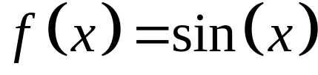

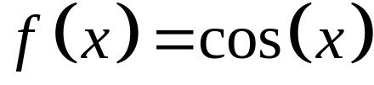
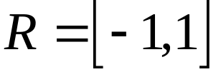
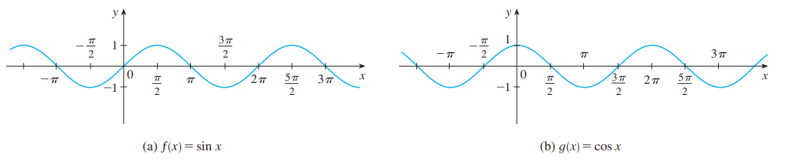
1.2. Functions and models
Trigonomatric functions
Notes:
Sin(-x)=sinx
Cos(-x) = cosx
R = [-1, 1]

Slide 36
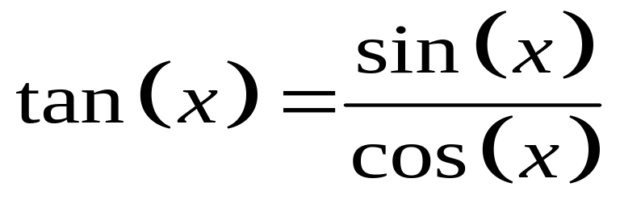
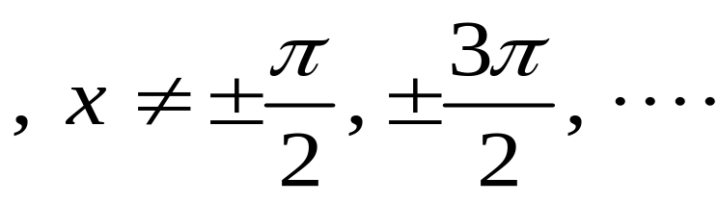
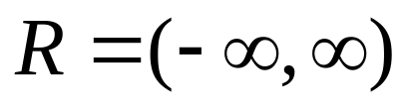
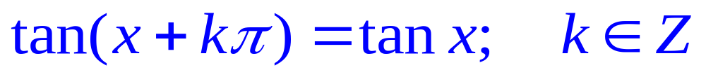
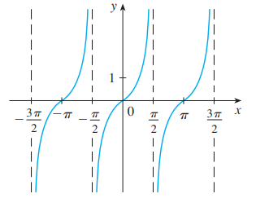
1.2. Functions and models
Trgonomatric functions
Notes:
Sin(-x)=sinx
Cos(-x) = cosx
R = [-1, 1]

Slide 37
1.2. Functions and models
Trgonomatric functions
Notes:
Sin(-x)=sinx
Cos(-x) = cosx
R = [-1, 1]

Slide 38
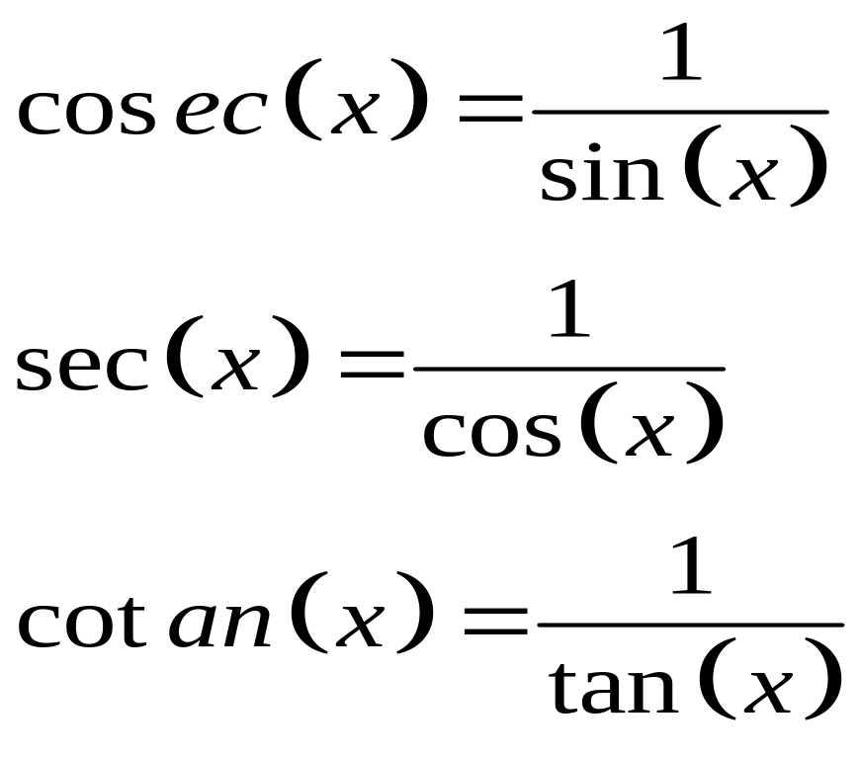
1.2. Functions and models
Trgonomatric functions
The reciprocals of the sine, cosine, and tangent functions are

Slide 39
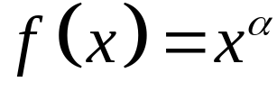
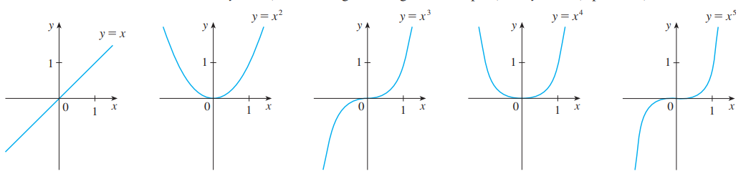
1.2. Functions and models
Trgonomatric functions
A function of the form , where a is constant, is called a power function.
Notes:
Domain?
Range?

Slide 40



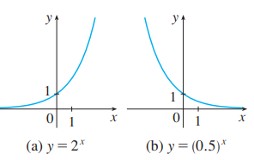
1.2. Functions and models
Exponential function
The exponential functions are the functions of the form , where the base a is a positive constant.
  - The graphs of y = 2^{x} and y = (0.5)^{x} are shown.
- In both cases, the domain is and the range
is .
Notes:
Domain?
Range?
Graph when a>1; a<1

Slide 41
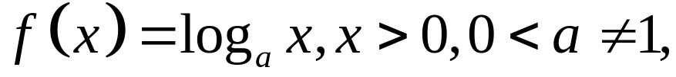

1.2. Functions and models
Logarithmic funtions
The logarithmic functions
where the base a is a positive constant, are the inverse functions of the exponential functions.
The figure shows the graphs
of four logarithmic functions
with various bases.
Notes:
0<a≠1; x>0

Slide 42

1.2. Functions and models
Shifting
Why don’t we consider the case c < 0 ?
Suppose c > 0.
  To obtain the graph of
  y = f(x) + c, shift the
  graph of y = f(x)
  a distance c units upward.
  To obtain the graph
  of y = f(x) - c, shift
  the graph of y = f(x)
  a distance c units
  downward.
Notes:
f+c; f-c8459

Slide 43
1.2. Functions and models
Shifting
  - To obtain the graph of
  y = f(x - c), shift the graph
  of y = f(x) a distance c
  units to the right.
  - To obtain the graph
  of y = f(x + c), shift
  the graph of y = f(x)
  a distance c units to
  the left.
Notes:
f+c; f-c8459

Slide 44

1.2. Functions and models
Transformations
How about the case c < 1 ?
Suppose c > 1.
- To obtain the graph of y = cf(x), stretch the graph of y = f(x) vertically by a factor
of c.
- To obtain the graph of y = (1/c)f(x), compress the graph
of y = f(x) vertically by a factor of c.
Notes:
f.c; f/c

Slide 45
1.2. Functions and models
Transformations
  - In order to obtain the
  graph of y = -f(x), reflect
  the graph of y = f(x) about
  the x-axis.
  - To obtain the graph
  of y = f(-x), reflect the graph of y = f(x)
  about the y-axis.
Notes:
f.c; f/c

Slide 46


1.2. Functions and models
Transformations
Example:
Given the graph of
Use transformations to graph

Slide 47

1.2. Functions and models
Transformations
Solution:
We have

Slide 48




1.2. Functions and models
Transformations
Solution:
  : by reflecting about the x-axis.
  : by stretching vertically by a factor of 2.
  : by reflecting about the y-axis

Slide 49


















1.2. Functions and models
Transformations_Summary
Tranformation of | Effect on the graph of
 | Vertical shift up units
 | Vertical shift down units
 | Shift left by units
 | Shift right by units
 | Vertical stretch if Vertical compression
 | Horizontal stretch Horizontal compression if
 | Reflection about the
 | Reflection about the

Slide 50

1.2. Functions and models
Transformations
Example 1: The figure illustrates these stretching
transformations when applied to the cosine
function with c = 2.

Slide 51
1.2. Functions and models
Transformations
Example 2: Suppose that the graph of f is given. Describe how the graph of the function f(x-2)+2 can be obtained from the graph of f. Select the correct answer.
a. Shift the graph 2 units to the left and 2 units down.
b. Shift the graph 2 units to the right and 2 units down.
c. Shift the graph 2 units to the right and 2 units up.
d. Shift the graph 2 units to the left and 2 units up.
e. none of these
Notes:
Answer: c

Slide 52



1.2. Functions and models
Combinations of functions
Two functions f and g can be combined to form new
functions:
  a/
  b/
  c/
Notes:
Domain of new function

Slide 53


1.2. Functions and models
Composite of functions
Given functions f and g, the composite function is
defined by
Notes:
Domain of new function

Slide 54
1.2. Functions and models
Example 1:
Let h(x)=f(g(x)). If f(x)=x-1 and g(x)=3x+2 then h(x) is ?
Notes:
Answer: 1) d 2) a

Slide 55


1.2. Functions and models
Example 2:
Evaluate
5 b. 1
c. 2 d. None of the others
x | 1 | 2 | 3 | 4 | 5 | 6
 | 3 | 2 | 1 | 0 | 1 | 2
 | 6 | 5 | 2 | 3 | 4 | 6
.
Notes:
Answer: 3b; 4b

Slide 56

1.2. Functions and models
Example 2:
Evaluate
5 b. 1
c. 2 d. None of the others
x | 1 | 2 | 3 | 4 | 5 | 6
 | 3 | 2 | 1 | 0 | 1 | 2
 | 6 | 5 | 2 | 3 | 4 | 6
.
Notes:
Answer: 3b; 4b

Slide 57

1.2. Functions and models
Example 3:
Let h(x)=f(g(x)).
1/ If g(x)=x-1 and h(x)=3x+2 then f(x) is:
a. 3x+3 b. 3x+4
c. 3x+1 d. None of them
2/ If h(x)=3x+2 and f(x)=x-1 then g(x) is:
a. 3x+3 b. 3x+4
c.3x+1 d. None of them
3/ If f and g are functions, then
a. True b. False
Notes:
Answer: 1) d 2) a

Slide 58
1.2. Functions and models
Notes:
MODEL = FUNCTION

Slide 59


1.2. Functions and models
Label the following graphs
Notes:
Answer: ½ f(x), f(½ x), f(x)

Slide 60


1.3. The limit of a function
The limit of a function
In general, we write
if we can make the values
of f(x) arbitrarily close to L
by taking x to be
sufficiently close to a
but not equal to a.
Notes:
f close to L by taking x to be sufficiently close to a but not equal to a

Slide 61


1.3. The limit of a function
One-sided limits
We write if we can make the values of f (x) arbitrarily close toL by taking x to be sufficiently close to a and x less than a.
Notes:
f close to L by taking x to be sufficiently close to a but not equal to a

Slide 62




1.3. The limit of a function
One-sided limits
Similarly, “the right-hand limit of f(x) as x approaches a is
equal to L” and we write
Notes:
f close to L by taking x to be sufficiently close to a but not equal to a

Slide 63


A numerical and graphical approach
1.3. The limit of a function
Let
a/ What is
b/ What is the limit of as approaches ?

Slide 64




1.3. The limit of a function
A numerical and graphical approach
Solution:
a/ Since , we will substitute in for , giving us the new equation
Solving for , we get
Thus does not exist.

Slide 65





1.3. The limit of a function
A numerical and graphical approach
b/ First let approach from the left:
Thus it appears that
Next let approach from the right: Thus it appears that
Since both the left-hand and right-hand limits agree, .

Slide 66



1.3. The limit of a function
A numerical and graphical approach
Example 1: Consider the function H given by
Graph the function, and find each of the following
limits, if they exist. When necessary, state that the
limit does not exist.
a/ b/

Slide 67




1.3. The limit of a function
Solution:
a/ First, let x approach 1 from the left:
Thus, it appears that
Then, let x approach 1 from the right:
Thus, it appears that

Slide 68

1.3. The limit of a function
Solution:
Since 1)
and
2)
Then, does not exist.

Slide 69



1.3. The limit of a function
Limit Graphically
Observe on the graph that:
1)
and
2)
Therefore, does not exist.

Slide 70






1.3. The limit of a function
Solution:
b/ First, let x approach from the left:
Thus, it appears that
Then, let x approach from the right:
Thus, it appears that

Slide 71

1.3. The limit of a function
Solution:
Since 1)
and
2)
Then,

Slide 72



1.3. The limit of a function
Limit Graphically
Observe on the graph that:
1)
and
2)
Therefore,

Slide 73






1.4. Calculating limits using the limit laws
The limit laws
Suppose that c is a constant and the limits
and exist. Then

Slide 74






1.4. Calculating limits using the limit laws
The limit laws
where n is a positive integer.

Slide 75



1.4. Calculating limits using the limit laws
Direct substitution property
We state this fact as follows. If f is a polynomial or a
rational function and a is in the domain of f, then
Theorem 1
if and only if

Slide 76


1.4. Calculating limits using the limit laws
Example:
a/ Show that
b/ Prove that does not exist.
Notes:
Use Vertical Test?

Slide 77




1.4. Calculating limits using the limit laws
Squeeze theorem
If when x is near a (except possibly at a) and .Then

Slide 78

1.4. Calculating limits using the limit laws
Example:
Show that
Notes:
Use Vertical Test?

Slide 79


1.4. Calculating limits using the limit laws
Solution
  Note that we cannot use
  This is because does not exist.

Slide 80






1.4. Calculating limits using the limit laws
  However, since ,
  We have:
Set .
We have
In the Squeeze Theorem, we obtain:

Slide 81


1.4. Calculating limits using the limit laws
Quiz questions
1/If then
a. True b. False
2/ If
a. True b. False
Notes:
Answer: 1b;2b . Give a sample ?

Slide 82





1.5. Continuity
Definition 1
A function f is continuous at a number a if
Notice that :
is defined - that is,
a is in the domain of f
exists.
.
Notes:
When function f is NOT continuous at a number a ?

Slide 83

1.5. Continuity
Definition 2
If f is defined near a - that is, f is defined on an open interval containing a, except perhaps at a - we say that f is discontinuous at a if f is not continuous at a.
The figure shows the
graph of a function f.
At which numbers is
f discontinuous ?
Why ?

Slide 84


1.5. Continuity
Definition 3
A function f is continuous from the right at a number a if
and f is continuous from the left at a if

Slide 85
1.5. Continuity
Definition 4
A function f is continuous on an interval if it is continuous at every number in the interval.
If f is defined only on one side of an endpoint of the interval, we understand ‘continuous at the endpoint’ to mean ‘continuous from the right’ or ‘continuous from the left.’

Slide 86

1.5. Continuity
Theorem
If f and g are continuous at a; and c is a constant, then the following
functions are also continuous at a:
1. f + g 2. f - g
3. c.f 4. f. g
5.

Slide 87
1.5. Continuity
Theorem
The following types of functions are continuous at every number in their domains:
  Polynomials
  Rational functions
  Root functions
  Trigonometric functions
Notes:
List domain of these functions

Slide 88


1.5. Continuity
Intermediate value theorem
Suppose that f is continuous on the closed interval [a, b] and let N be any number between f(a) and f(b), where
Then, there exists a number c in (a, b) such that f(c) = N.

Slide 89







1.5. Continuity
Intermediate value theorem
Example: Show that there is a root of the equation
between 1 and 2.
Let
We have and
Thus , that is, is a number between 1 and 2. Now is continuous since it is a polynomial, so the Intermediate Value Theorem says there is a number between 1 and 2 such that .
The equation has at least root in interval (1,2).
Notes:
Exists a root of the equation, can not solve

Slide 90







1.5. Continuity
Quiz questions
1/ If and then there exists a number c between 1 and 3 such that
a.True b. False
2/ Which is the equation expressing the fact that “ is continuous at 2”?
a. b.
c. d.
e.
Notes:
Answer: 1b, 2e

Slide 91


1.6. Limits involving infinity
Infinite limits
Let f be a function defined on both sides of a, except possibly at a itself. Then,
means that the values of
can be made arbitrarily large
by taking x sufficiently
close to a, but not equal to a.
Notes:
For example

Slide 92


1.6. Limits involving infinity
Infinite limits
Let f be a function defined on both sides of a, except possibly at a itself. Then,
means that the values of
can be made arbitrarily large
by taking x sufficiently
close to a, but not equal to a.
Notes:
For example

Slide 93





1.6. Limits involving infinity
Infinite limits
Similar definitions can be given for the one-sided limits:

Slide 94

1.6. Limits involving infinity
Definition
is called the vertical asymptote of if we have one of the following:

Slide 95


1.6. Limits involving infinity
Definition
The line is called the horizontal
asymptote of if we have one of the following:
Notes:
For example

Slide 96

1.6. Limits involving infinity
Example: Find the asymptotes of the function

Slide 97



1.6. Limits involving infinity
Solution:
Don’t have vertical asymptote.
So, is horizontal asymptote

Slide 98




1.6. Limits involving infinity
Limits at infinity
Let be a function defined for every . Then
means that

Slide 99




1.6. Limits involving infinity
Example: Compute
a/ b/
c/ d/
Notes:
Using limit laws

Slide 100


1.6. Limits involving infinity
Quiz questions
1/ Find
a.0 b. infinity
c. 1 d. Does not exist
2/ Find
a. 0 b. infinity
c. 1 d. Dose not exist

Slide 101


1.6. Limits involving infinity
Quiz questions
3/ If then
a. True b. False
4/A function can have two different horizontal asymptotes
a. True b. False
Notes:
For example…

Slide 102





1.6. Limits involving infinity

Slide 103
The End
Notes:
Using limit laws

